Slide 1

-Design Review- Wave-Motion Arduino Shield
Presented By: Jordan Visser & Steven Diemer
EGR 326: Embedded System Design
Instructor: Andrew Sterian

Slide 2
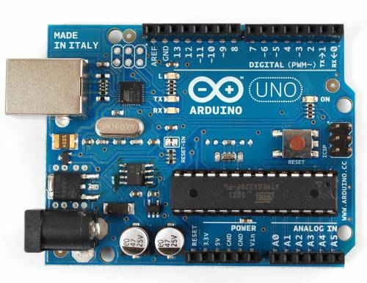
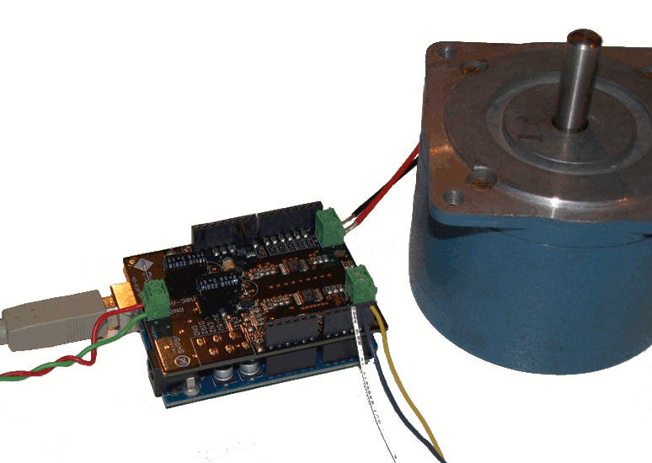
Project Scope
Project Summary
Design and Market an Arduino Shield
What is an Arduino?
What is an Arduino Shield?

Slide 3
Project Motivation
What is it that we are building?
Why are we building it?
Wanted to build something that…
Is fun and also “hackable”/expandable
Provided an opportunity to become familiar in many areas we have not previously been exposed to
Flash Memory
DAC
Accelerometer
Speaker & Microphone (Audio Capture/Playback)

Slide 4
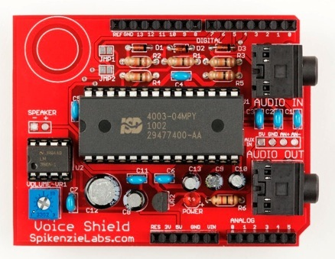
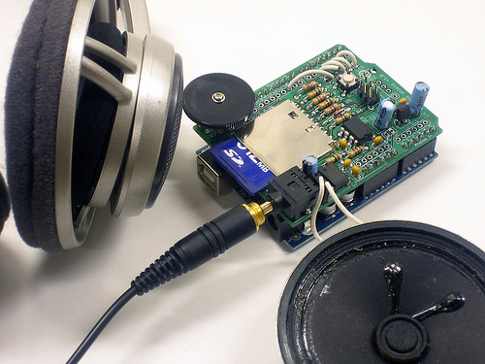
Wave-Motion vs. Existing Products
SpikenzieLabs Voice Shield
Ladyada Wave Shield

Slide 5
Functional Requirements
120 seconds of audio storage at 10-bit 16KHz sampling
rate (minimum)
2) 10-bit 16KHz recording/playback (with no re-sampling)
3) (+/- 8g) 3-Axis Accelerometer Controlled Playback

Slide 6
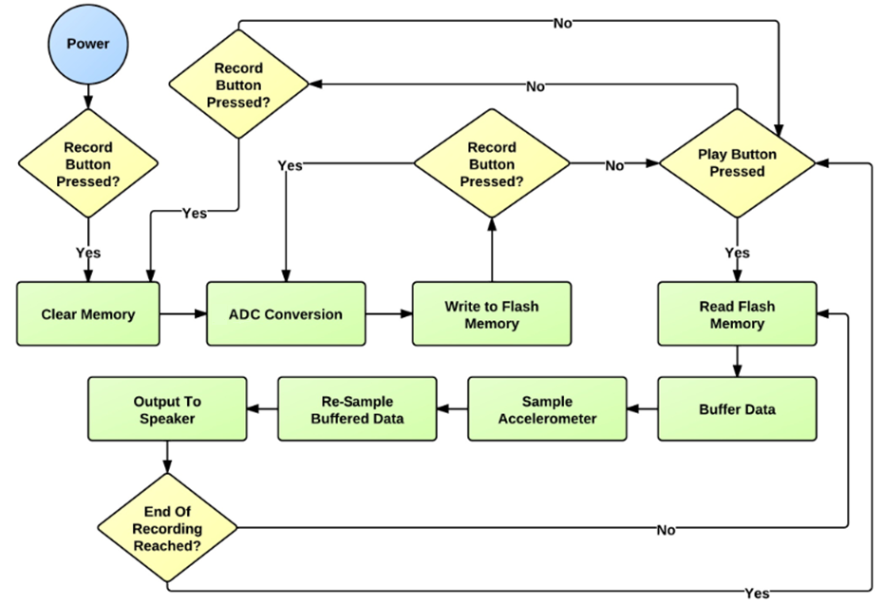
Wave-Motion Flow Chart

Slide 7
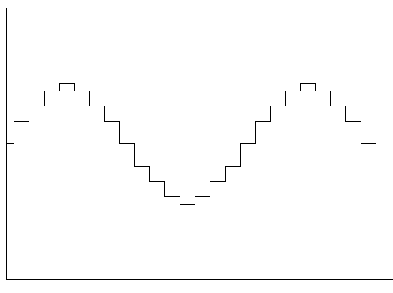
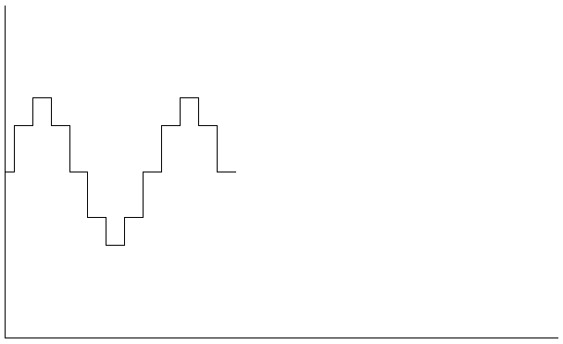
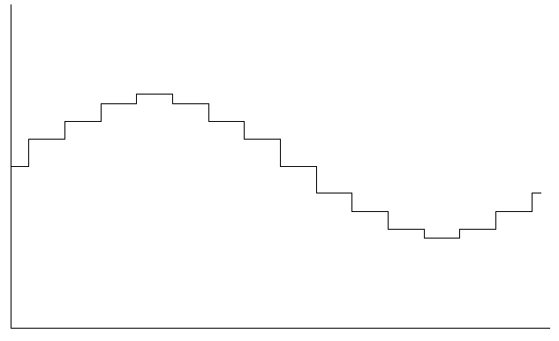
Audio Re-Sampling
Native Signal
2x Frequency of Native Signal
1/2 Frequency of Native Signal

Slide 8
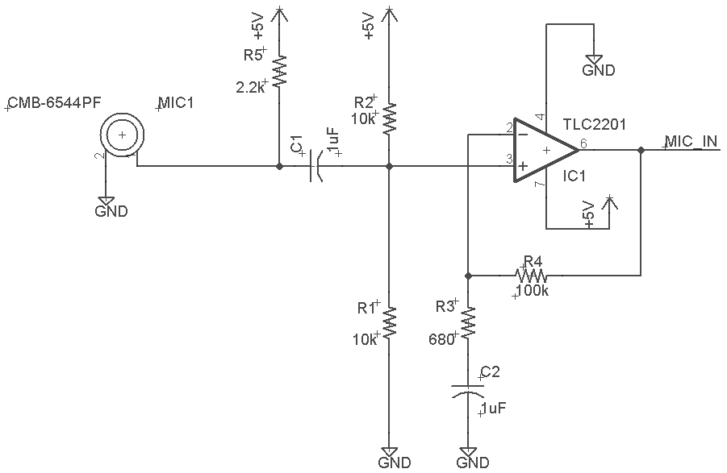
Microphone Pre-Amplifier

Slide 9
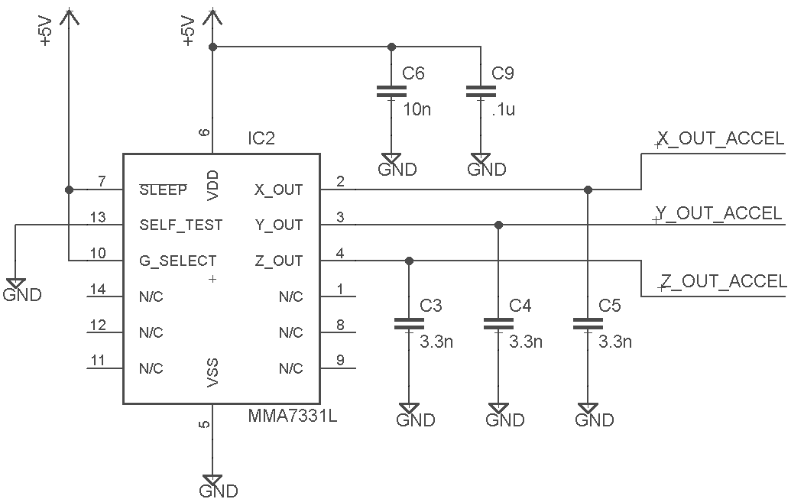
3-Axis Accelerometer

Slide 10
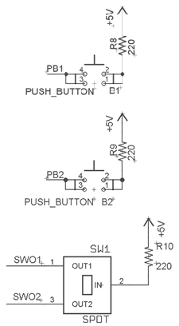
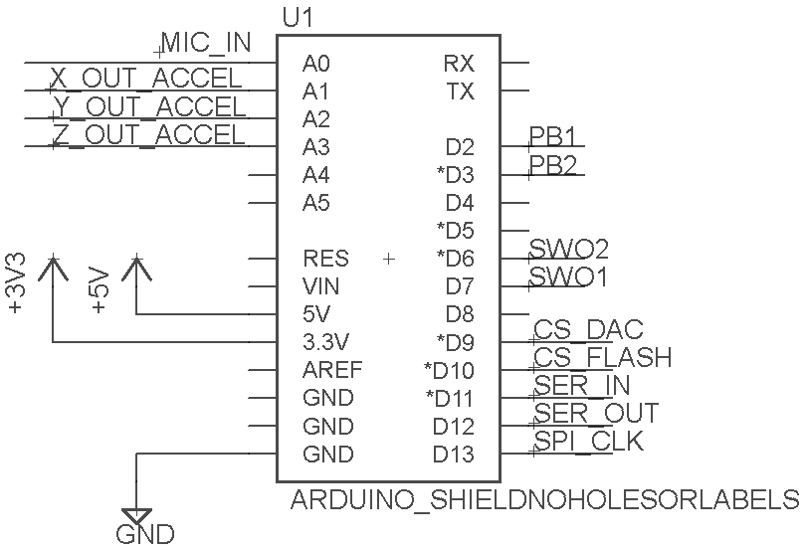
Arduino Pin-Out, Switch and Push Buttons

Slide 11
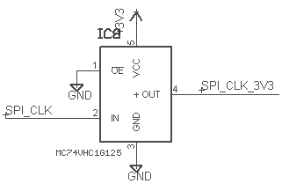
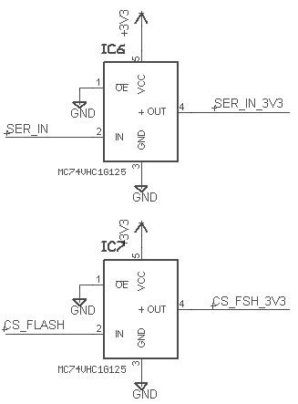
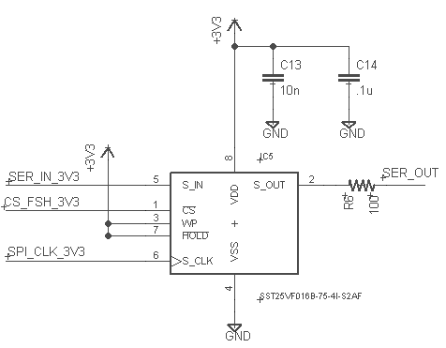
Level Shifters and Flash Memory

Slide 12
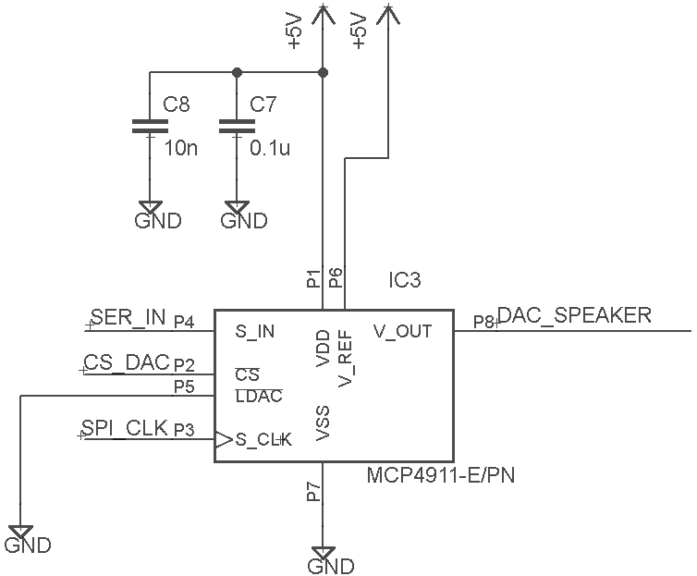
Digital-to-Analog Converter

Slide 13
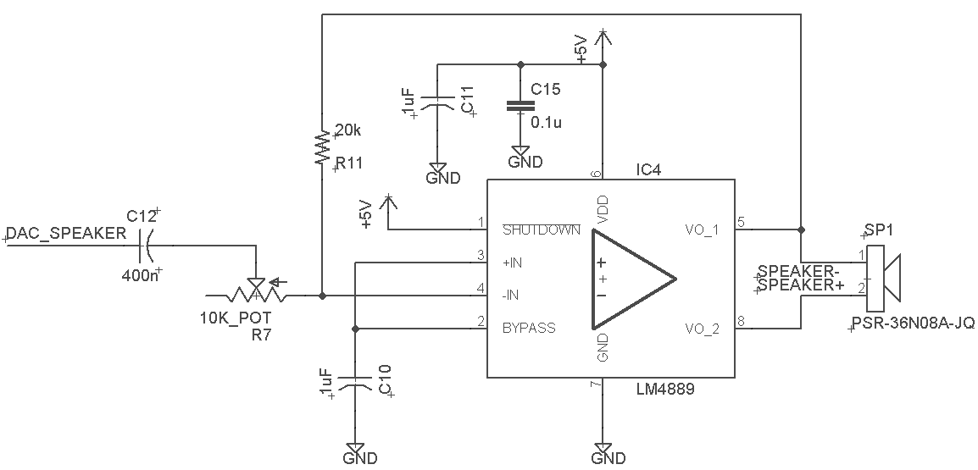
Speaker Amplifier

Slide 14
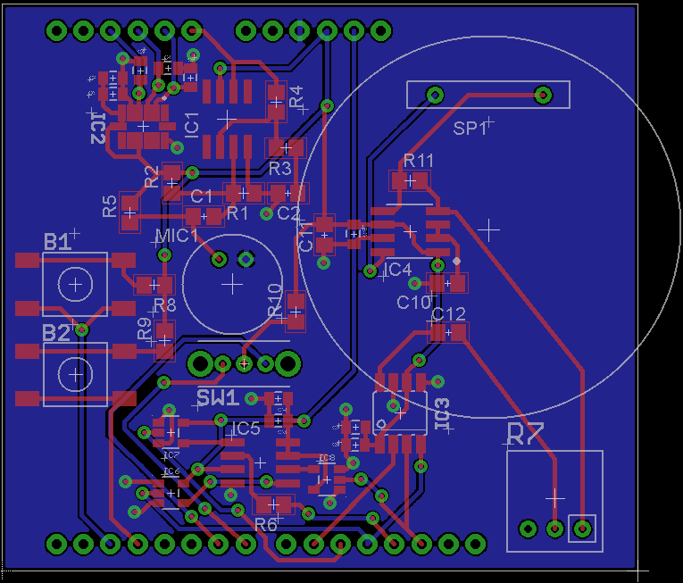
PCB Layout

Slide 15
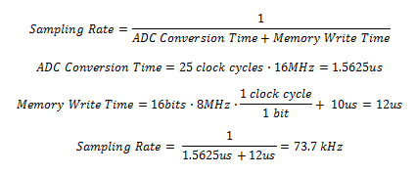
Relevant Calculations
Sampling Rate: 73.7 kHz (optimal)

Slide 16
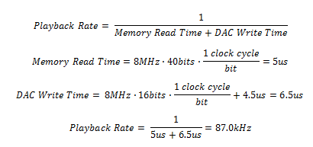

Relevant Calculations (Continued)
Playback Rate: 87.0 kHz (optimal)
Record Time: 125 seconds

Slide 17
- End -
We are now open for questions.
Thank You

